Slide 1


Slide 2


INTRODUCTION CLASS
ENGLISH FOUR
By: Ma. Cristina Basantes
Notes:
Edit TOPIC and place the name of the teacher who designed the class

Slide 3





Slide 4
Problems with Moodle registration?
Problems with registration on Aula Virtual?
instituto.idiomas@uleam.edu.ec
Questions about payment?

Slide 5



Slide 6

Recommendations
Avoid background noise
Use earphones or headphones
Keep your microphone off
If posible, keep your camera on
Find a nice place to study
Use English the most you can
Participate actively

Slide 7





CONTACT POINTS & SOFTWARE TO USE
Virtual classes & groups chats
Autonomous work
Aula virtual (attendance)

Slide 8
Blended Learning
Synchronous | Asynchronous
Microsoft Teams (4 hours per week) | Moodle
Live classes and activities, presentation, discussions, etc | Videos, readings, audios, presentations, quizzes, etc. Homework & Exams
Notes:
06’ - 10’ If possible, provide an example of what an expected average achiever response will look like

Slide 9


Slide 10
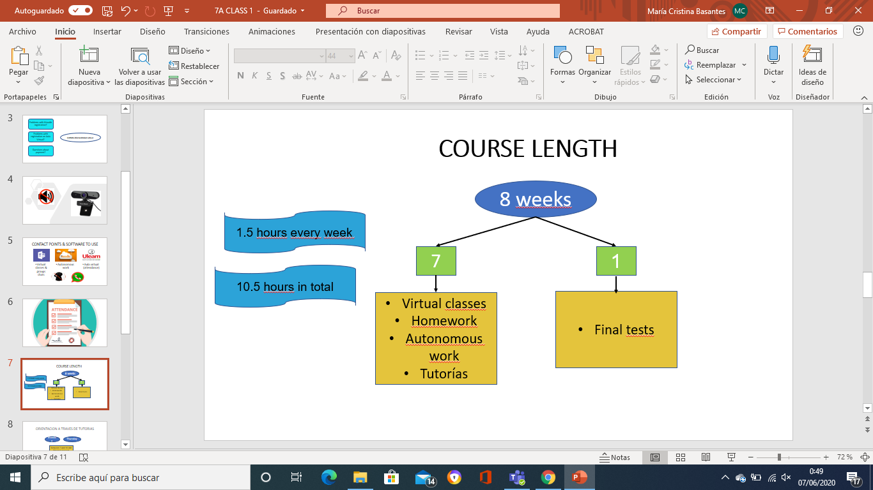
COURSE LENGTH
4 hours every week
28 hours in total

Slide 11
Actuaciòn (Actividades de Docencia) | Actividades en clase | /10 | Promedio de todas las actividades | 10%
Producciòn (Trabajo Autònomo) | Tareas en Moodle | /10 | Promedio de todas las tareas | 10%
Producciòn (Pràctica y experimentaciòn de aprendizajes) | Listening | /10 | Promedio de ambos | 40%
 | Speaking | /10
Acreditaciòn (Evaluaciòn Final) | Reading | /10 | Promedio de ambos | 40%
 | Writing | /10

Slide 12
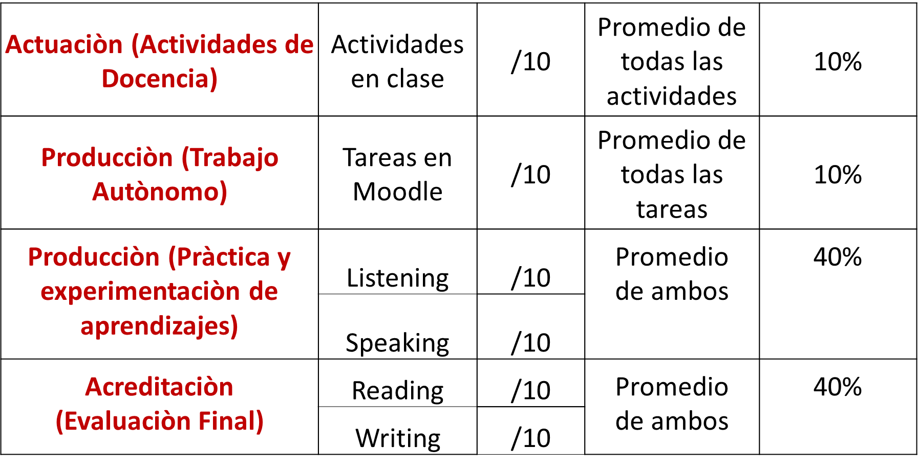

Slide 13
START & END OF VIRTUAL CLASSES.
Each class will start with a review of the
previous lesson, a mini quiz, brainstorming of
ideas, questions that you might have about the previous lessons.
If you have any questions about activities/tasks assigned on Moodle, you can ask them at the end of the second lesson of the week.

Slide 14

PROFICIENCY EXAM = EXAMEN DE SUFICIENCIA

Slide 15


QUESTIONS?

Slide 16


Slide 17


Slide 18
Learning Outcomes
Methodology of the course
Tools: Microsoft Teams and Moodle
Grades
Recommendations
Introduce yourself
Imperatives
Notes:
06’ - 10’ What will be learnt, improved or done after the session?

Slide 19

Let’s get to know each other
Names
Age
Date of birth
Location
Studies
Favorite Holiday

Slide 20

Imagine that one of your friends or relatives is sick. What advice would you give to him/her?
l
l
l
l
l
l

Slide 21

Let’s compare the structure of an imperative and a normal sentence.
You take your medicine every day.
Take your medicine.
S
V
C
V
C
What is the difference?

Slide 22
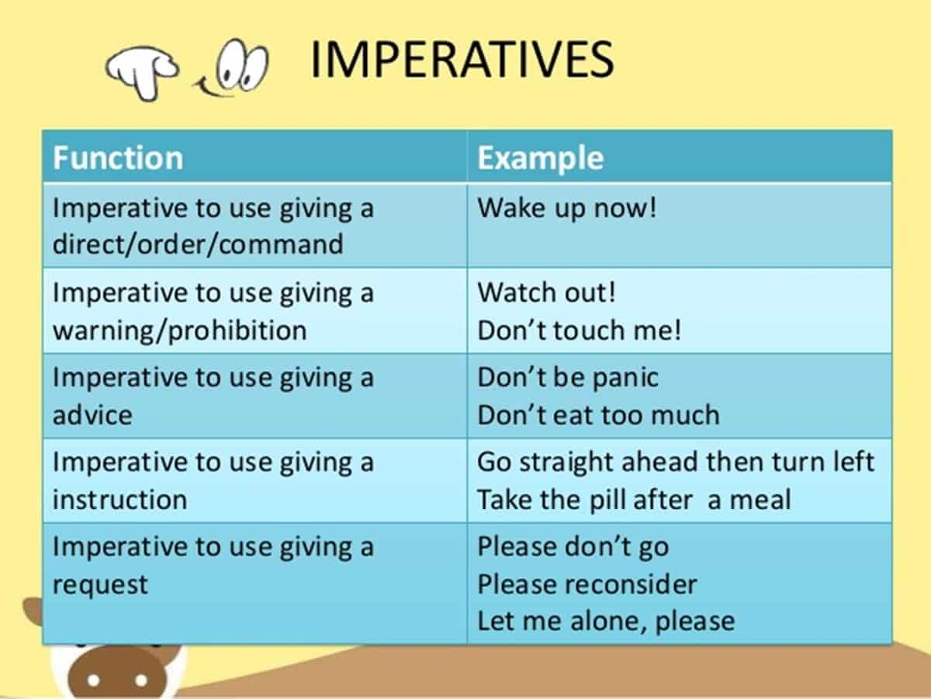
Give me an example of each function of imperative sentences.

Slide 23

Let’s work on imperatives together!
https://www.englisch-hilfen.de/en/exercises/various/imperative.htm

Slide 24

Your turn to practice! Then we’ll check together.
Year 5 Grammar Revision - Imperative Sentences worksheet (liveworksheets.com)
Notes:
Grammar check

Slide 25

Let’s try to match the road signs with their meanings.
https://wordwall.net/resource/17013865/road-signs

Slide 26


Slide 27
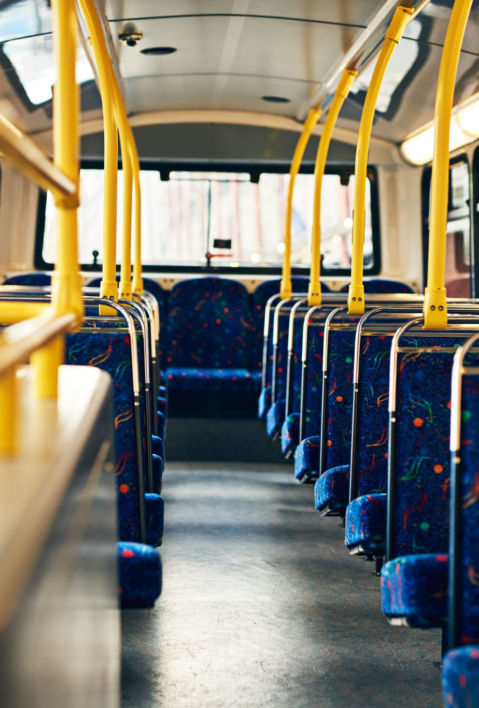
Unscramble the sentences.
seat belt/your/wear/always/must
talk to/driver/don’t/the
before/the street/look/both ways/crossing
into/don’t run/the/road
the/pavement/walk/on

Slide 28

Unscramble the sentences.
your bike/good/in/make sure/is/working conditions
the/traffic/ride/against/with/flow/not/of/it
block/mirror/view/Don’t/the/rear
on/a second/carry/your/never/person/bike
between/Don’t/cars/cross/parked

Slide 29

GROUP WORK
In groups of ___, create dialogues including the following:
at least three imperative sentences.
Vocabulary of traffic sign.
You should turn on your camera and your microphone when it is your group’s turn to participate.
Each member of the group should participate within the group and in the main session to get a grade.

Slide 30


